Slide 1

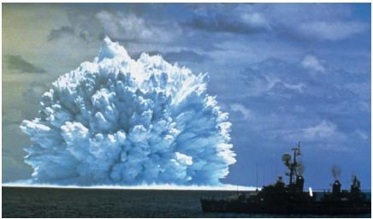
Nuclear
Reactions
Mass is converted to energy.
Think E=mc².
Produce tremendous amounts of energy!!!
2 Types: Fission and Fusion
Nuclear explosion at sea

Slide 2
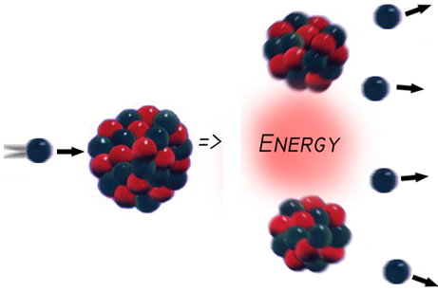
Nuclear Fission
Type of nuclear rxn.
Splitting of nucleus of a large atom into two or more fragments.
Produces additional neutrons and a lot of energy.
*Think binary fission or fissure. (splitting)

Slide 3
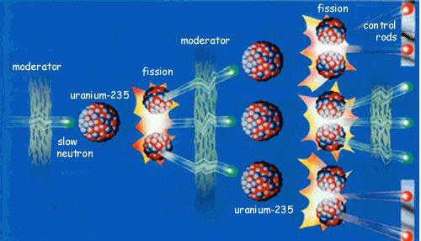
Chain
Reactions
Each nucleus emits 3 neutrons that can cause the fission of another radioactive nucleus and so on.
Continues until a stable compound forms.
Ex: Atomic Bomb.
Nuclear reactors can control fission chain reactions and convert released energy into electric power.

Slide 4
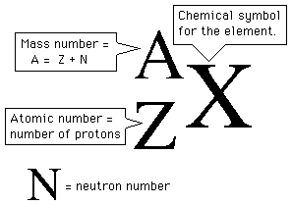
Notation

Slide 5
Isotopes
Atoms of a given element with:
same #protons
but
different # neutrons

Slide 6
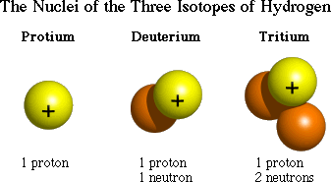
H H H
http://education.jlab.org/glossary/isotope.html

Slide 7


3 Main Types of Radioactive Decay
Alpha α
Beta β
Gamma γ

Slide 8
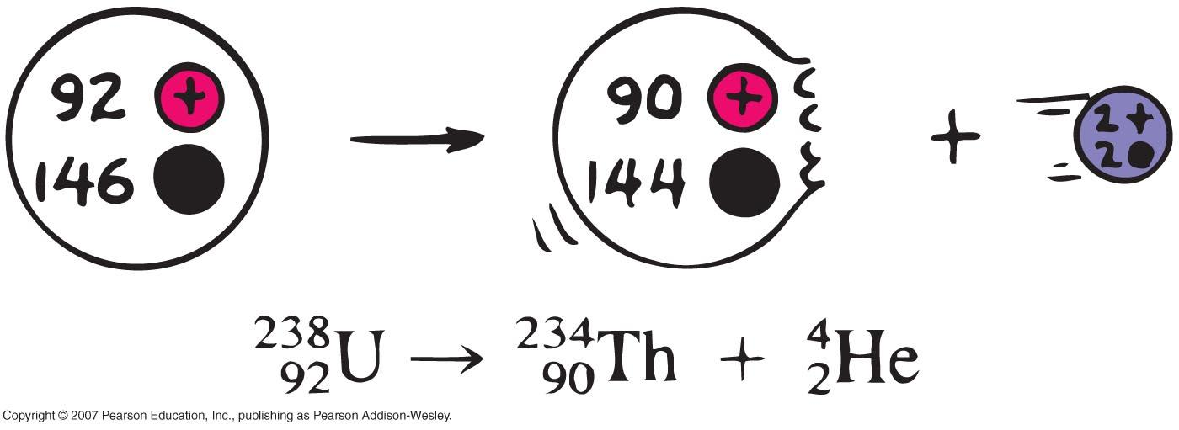
Alpha Decay
Uranium Thorium

Slide 9

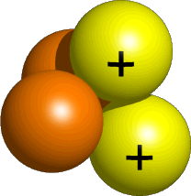
Alpha Decay
Emission of alpha particles α :
helium nuclei
two protons and two neutrons
charge +2e
can travel a few inches through air
can be stopped by a sheet of paper, clothing.

Slide 10

Beta Decay
Beta particles β: electrons ejected from the nucleus when neutrons decay
( n -> p⁺ +β⁻ )
Beta particles have the same charge and mass as "normal" electrons.

Slide 11
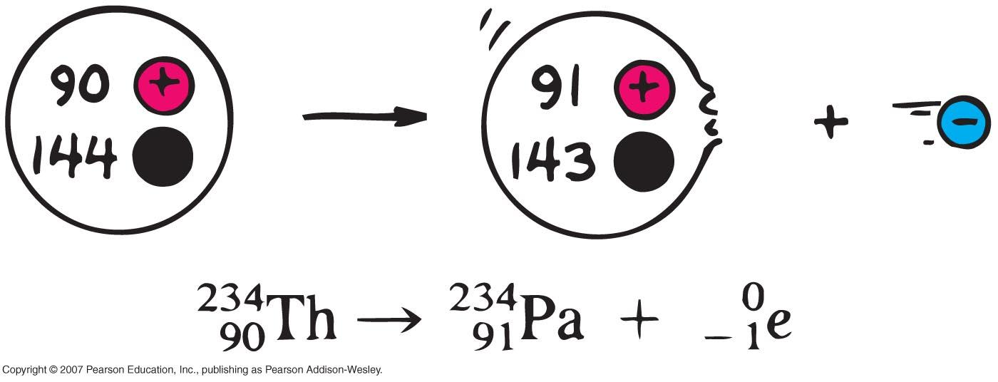
Beta Decay
Thorium Protactinium

Slide 12
Gamma Decay
Gamma radiation γ : electromagnetic energy that is released.
Gamma rays are electromagnetic waves.
They have no mass.
Gamma radiation has no charge.
  Most Penetrating, can be stopped by 1m thick concrete or a several cm thick sheet of lead.

Slide 13




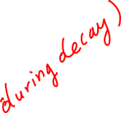




Examples of Radioactive Decay
Alpha Decay
Po → Pb + He
Beta Decay p→ n + e
n → p + e
C → N + e
Gamma Decay
Ni → Ni + γ
(excited nucleus)

Slide 14
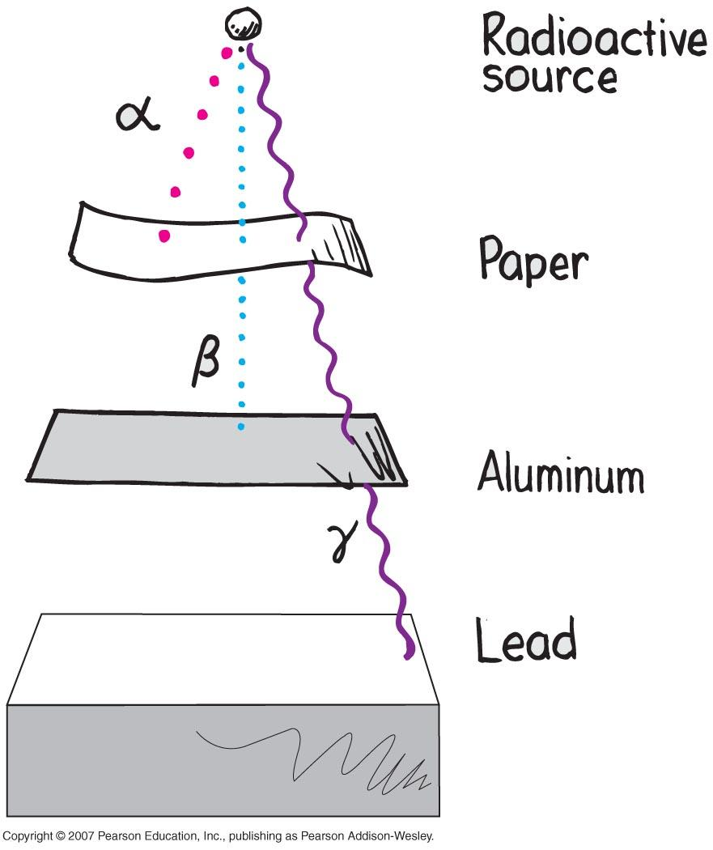

Slide 15

Nuclear
Fusion
Two nuclei unite to form a heavier nucleus with release of enormous amounts of energy.
High temps and High pressures are necessary.
Occurs in the Sun and stars and the Hydrogen Bomb.
Think Unite, Fusion.
1st aerial test of H-bomb makes Bikini Atoll unlivable

Slide 16
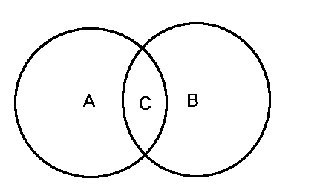
Compare & Contrast Fission and
Fusion
Similarities
Both release a lot of energy.
Both convert mass into energy.
Differences
Fission:splitting Fusion: uniting
Fusion releases much more energy than fission.
Fission produces radioactive waste, fusion only produces He.

Slide 17

How do stars create energy?

Slide 18
Nuclear Fusion Reactoins
4 (¹H) ------> ⁴ He + 2 e⁺ + 2 neutrinos + energy3 (⁴He) ------> ¹²C + energy
¹²C + ¹²C ------> ²⁴Mg + energy
¹²C + ⁴ He ------> ¹⁶O + energy
¹⁶O + ¹⁶O ------> ³²S + energy
¹⁶O + ⁴ He -----> ²⁰Ne +energy
²⁸Si + 7(⁴ He) ------> ⁵⁶Ni + energy
⁵⁶Ni ------> ⁵⁶Co + e⁺ (postive Beta Decay)
⁵⁶Co ------> ⁵⁶Fe + e⁺ (positive Beta Decay)
⁵⁶Fe + n ------> ⁵⁷Fe
⁵⁷Fe + n ------> ⁵⁸Fe
⁵⁸Fe + n ------> ⁵⁹Fe

