Slide 1

Chemical Reactions

Slide 2
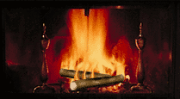
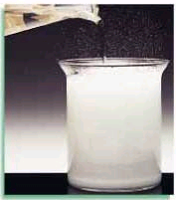
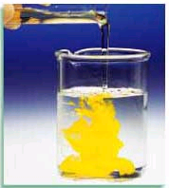
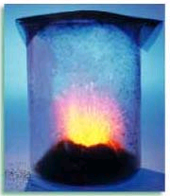
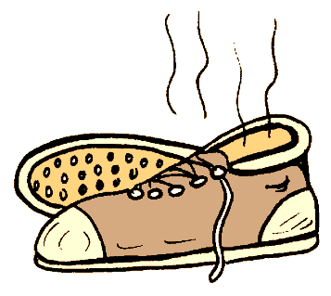
Indicators of chemical reactions
Emission of light or heat
Formation of a gas
Formation of a precipitate
Color change
Emission of odor

Slide 3
All chemical reactions:
have two parts
Reactants - the substances you start with
Products- the substances you end up with
The reactants turn into the products.
Reactants → Products

Slide 4
Describing chemical reaction
The way atoms are joined is changed
Atoms aren’t created or destroyed.
Can be described several ways
In a sentence
Copper reacts with chlorine to form copper (II) chloride.
In a word equation
Copper + chlorine → copper (II) chloride
Cu_{(s)} + Cl_{2(g)} → CuCl_{2(aq)}

Slide 5
Symbols used in equations
(s) after the formula –solid Cu_{(s)}
(g) after the formula –gas H_{2 (g)}
(l) after the formula -liquid H₂O_{(l)}
(aq) after the formula - dissolved in water, an aqueous solution. CaCl_{2 (aq)}
↑ used after a product indicates a gas (same as (g)) O₂ ↑
↓ used after a product indicates a solid (same as (s)) CaCo₃ ↓

Slide 6




Symbols used in equations
indicates a reversible reaction.
shows that heat is supplied to the reaction.
, or is used to indicate a catalyst used supplied, in this case, platinum.
, indicates a pressure other than STP

Slide 7
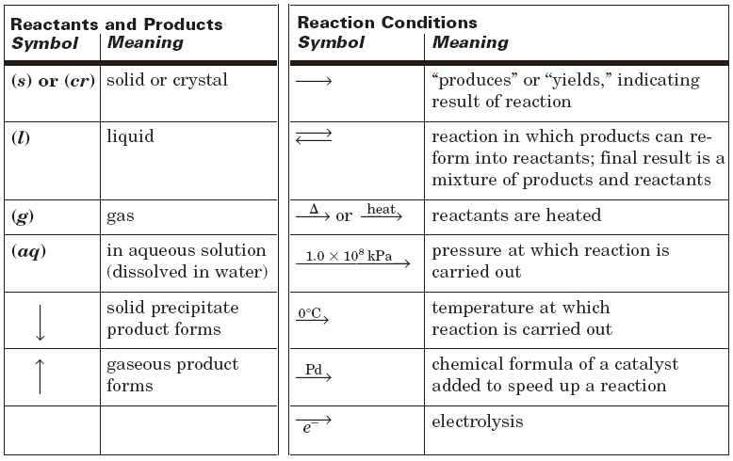
Summary of Symbols

Slide 8
What is a catalyst?
A substance that speeds up a reaction without being changed by the reaction.
Enzymes are biological or protein catalysts.

Slide 9
Reaction Energy
All chemical reactions are accompanied by a change in energy.
Exothermic - reactions that release energy to their surroundings (usually in the form of heat)
  ΔH (enthalpy) is negative – energy leaving system
Endothermic - reactions that need to absorb heat from their surroundings to proceed.
  ΔH (enthalpy) is positive – energy coming into the system

Slide 10
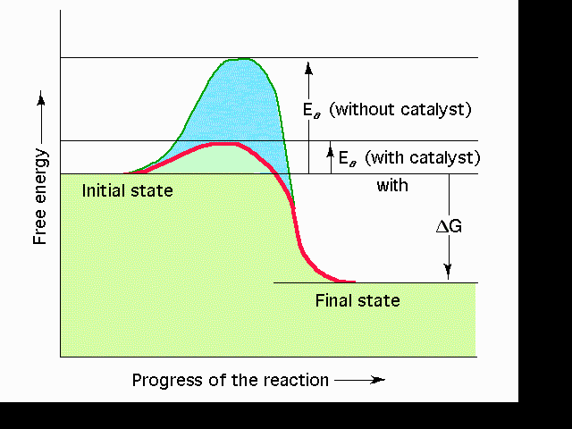
Reaction Energy
Spontaneous Reactions - Reactions that proceed immediately when two substances are mixed together. Not all reactions proceed spontaneously.
Activation Energy – the amount of energy that is required to start a chemical reaction.
  Once activation energy is reached the reaction continues until you run out of material to react.

Slide 12
Formula Equation
Uses formulas and symbols to describe a reaction
doesn’t indicate how many.
All chemical equations are sentences that describe reactions.

Slide 13
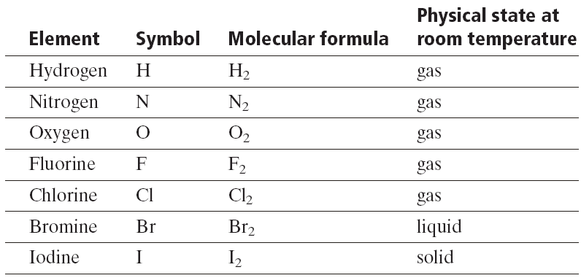
Diatomic elements
There are 8 elements that never want to be alone.
They form diatomic molecules.
H₂ , N₂ , O₂ , F₂ , Cl₂ , Br₂ , I₂ , and At₂
The –ogens and the –ines
1 + 7 pattern on the periodic table

Slide 15
Convert this to an equation
Solid iron (III) sulfide reacts with gaseous hydrogen chloride to form iron (II) chloride and hydrogen sulfide gas.
Fe₂S₃ _{(s)} + HCl_{(g)} → FeCl_{2 (s)} + H₂S_{(g)}

Slide 16
Convert this to an equation
Nitric acid dissolved in water reacts with solid sodium carbonate to form liquid water and carbon dioxide gas and sodium nitrate dissolved in water.
HNO₃ _{(aq)} + Na₂CO_{3 (s)} → NaNO₃ _{(aq)} + H₂O_{(l)}

Slide 17
The other way
Fe_{(s)} + O_{2(g)} → Fe₂O_{3(s)}
Solid iron reacts with oxygen gas to form solid iron oxide (rust).

Slide 18
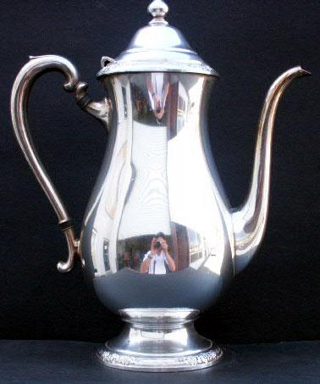
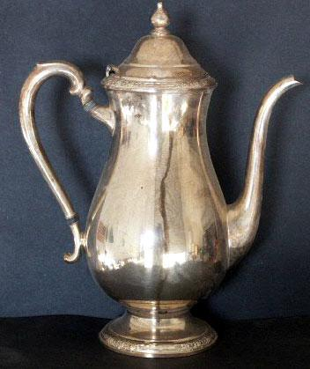
A silver spoon tarnishes. The solid silver reacts with sulfur in the air to make solid silver sulfide, the black material we call tarnish.
Ag _{(s)} + H₂S _{(g)} + O₂ _{(g)} → Ag₂S _{(s)} + H₂O

Slide 19
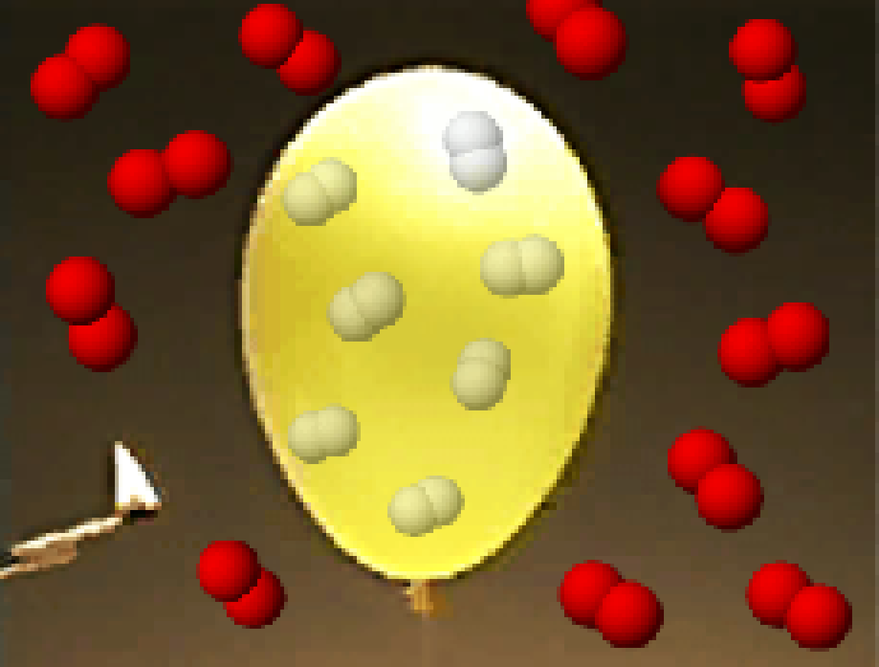
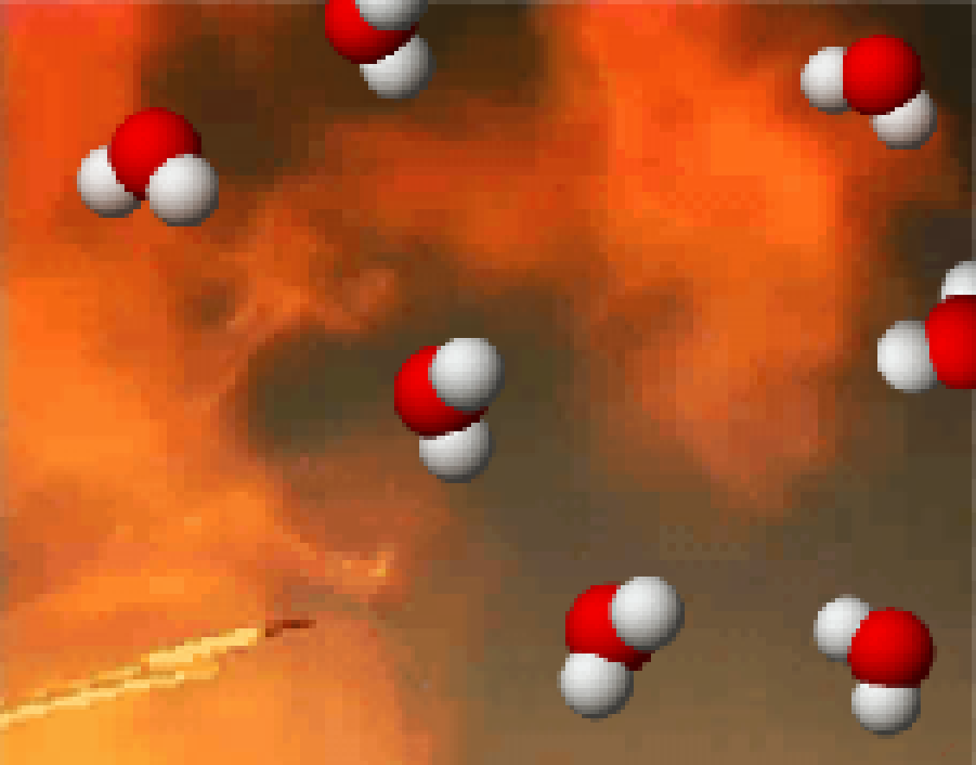
Balancing Equations
2
2
___ H₂(g) + ___ O₂(g) ---> ___ H₂O(l)
What Happened to the Other Oxygen Atom?
This equation is not balanced!
Two hydrogen atoms from a hydrogen molecule (H₂) combines with one of the oxygen atoms from an oxygen molecule (O₂) to form H₂O. Then, the remaining oxygen atom combines with two more hydrogen atoms (from another H₂ molecule) to make a second H₂O molecule.

Slide 20
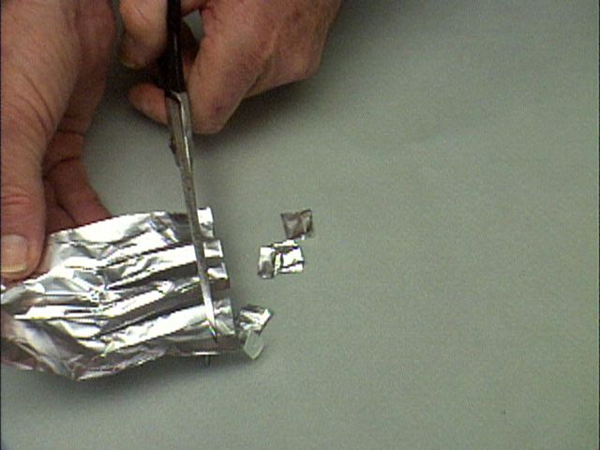

Slide 21
Translate Equation
Aluminum metal reacts with liquid bromine to form solid aluminum bromide
___ Al(s)
3
2
2
+ ___ Br₂(l)
→___ AlBr₃(s)

Slide 22
Translate some more!
calcium fluoride and sulfuric acid make calcium sulfate and hydrofluoric acid
calcium carbonate will come apart when you heat it to leave calcium oxide and carbon dioxide.
ammonia gas when it is pressed into water will make ammonium hydroxide.
aluminum sulfate and calcium hydroxide become aluminum hydroxide and calcium sulfate.
copper metal and silver nitrate react to form silver metal and copper (II) nitrate.
sodium metal and chlorine react to make sodium chloride.

Slide 24
Types of Reactions
There are millions of reactions.
Can’t remember them all
Fall into several categories.
We will learn 6 types.
We will be able to predict the products.
For some we will be able to predict whether they will happen at all.
We will recognize them by the reactants

Slide 25
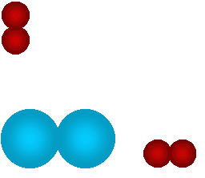
Synthesis Reactions
Also called combination reactions
2 elements, or compounds combine to make one compound.
A + B → AB
Na _{(s)} + Cl_{2 (g)} → NaCl _{(s)}
Ca _{(s)} +O_{2 (g)} → CaO _{(s)}
SO_{3 (s)} + H₂O _{(l)} → H₂SO_{4 (s)}
We can predict the products if they are two elements.
Mg _{(s)} + N_{2 (g)} →
Mg₃N₂ _{(s)}
Notes:
25

Slide 26
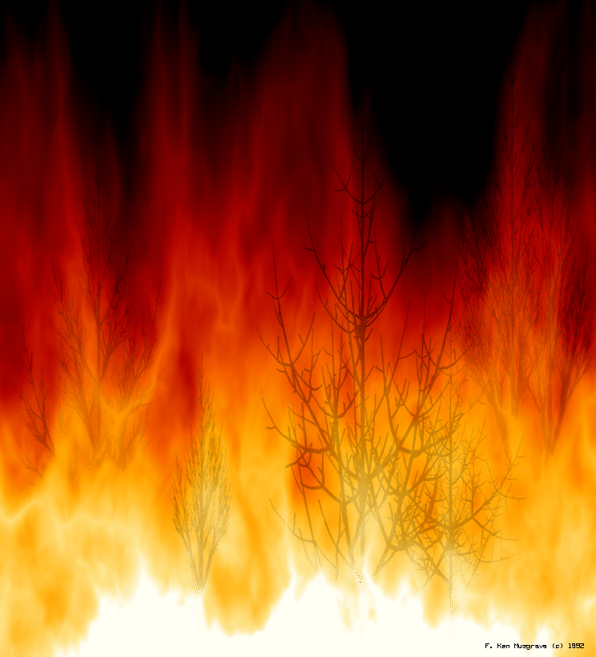
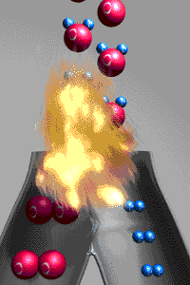
A simulation of the reaction:
2H₂ + O₂ → 2H₂O

Slide 27



Decomposition Reactions
decompose = fall apart
one compound (reactant) falls apart into two or more elements or compounds.
Usually requires energy
AB → A + B
NaCl Na + Cl₂
CaCO₃ CaO + CO₂
Notes:
27

Slide 28


Decomposition Reactions
Can predict the products if it is a binary compound
Made up of only two elements
Falls apart into its elements
H₂O
HgO
H₂ _{(g)} + O₂ _{(g)}
Hg _{(s)} + O₂ _{(g)}
Notes:
28

Slide 29
Decomposition Reactions
If the compound has more than two elements you must be given one of the products
The other product will be from the missing pieces
NiCO₃ _{(aq)}
H₂CO_{3(aq)} →
CO₂ _{(g)}
+ Ni _{(s)}
H₂ _{(g)}
+ CO₂ _{(g)}

Slide 30
Single Replacement
Also referred to as single displacement
One element replaces another
Reactants must be an element and a compound.
Products will be a different element and a different compound.
A + BC → AC + B
2Na + SrCl₂ → Sr + 2NaCl
F₂ + LiCl → LiF + Cl₂

Slide 31
Single Replacement
We can tell whether a reaction will happen
Some are more active than other
More active replaces less active
Notes:
31

Slide 32
Double Replacement
Two things replace each other.
Reactants must be two ionic compounds or acids.
Usually in aqueous solution
AB + CD → AD + CB
ZnS + 2HCl →
ZnCl + H₂S
AgNO₃ + NaCl →
AgCl + NaNO₃

Slide 33
Combustion
A reaction in which a compound (often carbon) reacts with oxygen
CH₄ + O₂ → CO₂ + H₂O
C₃H₈ + O₂ → CO₂ + H₂O
C₆H₁₂O₆ + O₂ → CO₂ + H₂O

Slide 34
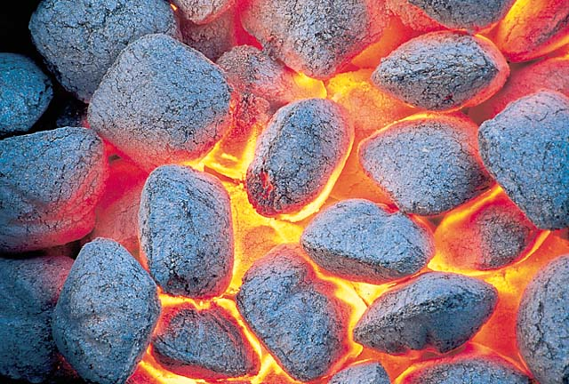
The charcoal used in a grill is basically carbon. The carbon reacts with oxygen to yield carbon dioxide. The chemical equation for this reaction is C + O₂ → CO₂

Slide 35
Acid/Base Reaction
An acid and a base react to form a salt and water.
Always in aqueous solution
Acid (H⁺) + Base (OH⁻) → Salt + H₂O
  NaOH + HCl → NaCl + H₂O
  NH₄OH + H₂SO₄ → (NH₄)₂SO₄ + H₂O

Slide 36
How to recognize which type
Look at the reactants
    Element(E), Compound(C)
E + E
C
E + C
C + C
Acid + Base
Look at the Products
CO₂ + H₂O
Synthesis
Decomposition
Redox
Single replacement
Double replacement
Acid/Base reaction
Combustion

Slide 37
Examples
H₂ + O₂ →
Synthesis
H₂O →
Decomposition
AgNO₃ + NaCl →
Double replacement
Zn + H₂SO₄ →
Single replacement
HgO →
Decomposition
KBr +Cl₂ →
Single replacement
Mg(OH)₂ + H₂SO₃ →
Double replacement

Slide 38
Examples
HNO₃ + KOH →
Acid/Base
CaPO₄ →
Decomposition
AgBr + Cl₂ →
Single replacement
Zn + O₂ →
Synthesis
HgO + Pb→
Single replacement
HBr + NH₄OH →
Acid/Base
Cu(OH)₂ + KClO₃ →
Double replacement
Notes:
38

Slide 39
Summary
An equation:
Describes a reaction
Must be balanced because to follow Law of Conservation of Energy
Can only be balanced by changing the coefficients.
Has special symbols to indicate state, and if catalyst or energy is required.
Can describe 5 different types of reactions.
Notes:
39

